Slide 1
Automation TCL Tool
NBDTP-HW Ali Sun/ Ryan Yu

Slide 2
Tool Introduction

Slide 3




使用工具
EXCEL VBA

Slide 4



TCL Tool 流程圖
Allegro
Python
Excel VBA
Result

Slide 5

TCL Tool 流程圖
Python

Slide 6
Tool Manual – I/O

Slide 7
SQS Excel
Allegro
Python
Excel VBA
Result
Step 1
手動將副檔名 .rpt 改成 .txt

Slide 8
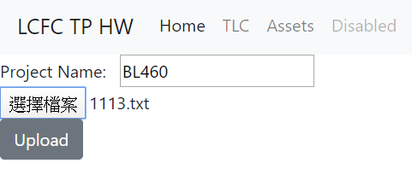
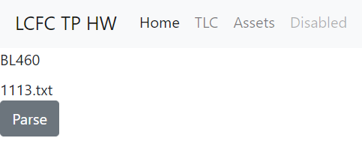
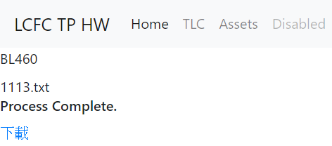
SQS Excel
Allegro
Python
Excel VBA
Result
Step 2
http://10.158.151.3:3000/tlc
Step 2
至 10.158.151.3:3000/tlc
Step 3
Step 3
Step 4
- 輸入案子名稱
- 選擇txt file
Step 4
按下Upload，上傳txt
Step 5
Step 5
檔案上傳成功後，按下Parse，網頁開始分析檔案。
Step 6
檔案處理完，會出現下載字樣，按下下載，excel會自動下載。
Step 6

Slide 9
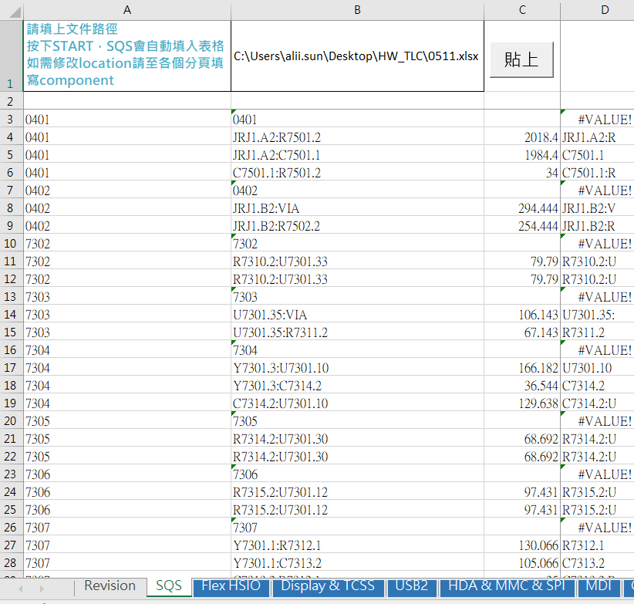
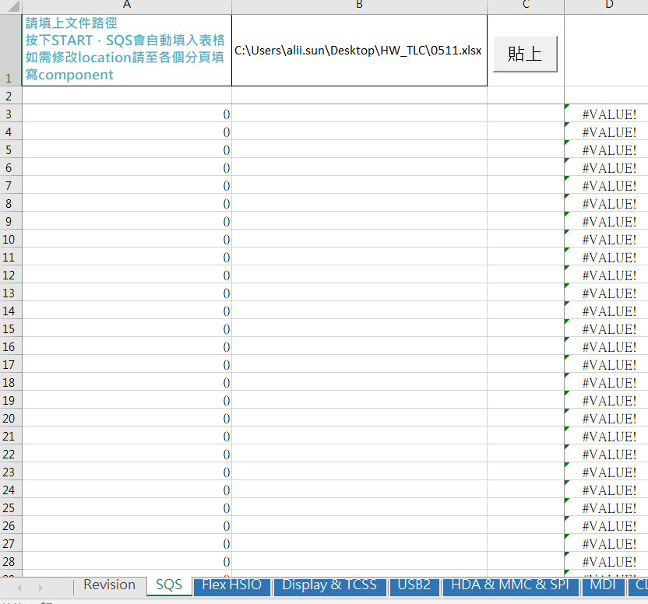
SQS Excel
Allegro
Python
Excel VBA
Result
Step 10
Step 7
Step 9
打開SQS excel
SQS Excel 檔案下載:10.158.132.53\tpehw1\3.1 Temp\TLC Tool
Step 8
點擊SQS分頁
Step 9
輸入網頁下載excel的路徑
Step 10
點擊貼上按鍵
Step 8
SQS Data 成功貼入

Slide 10
SQS Excel
Allegro
Python
Excel VBA
Result
Interface | Device Name | Signal Name | component A~Z;1~9 |  | Location Path | Each Pair Mismatch
 |  |  |  |  |  | 5.00
USB2.0 | USB DCI | USB2_P1_DP | U | J | 9511.64 | PASS
 |  | USB2_P1_DN | U | J | 9526.65 | -10.00
 | WWAN | USB2_P2_DP | U | R | 6778.14 | PASS
 |  | USB2_P2_DN | U | R | 6821.90 | -38.76
 | N/A | USB2_P3_DP | U | C | #N/A | #N/A
 |  | USB2_P3_DN | U | C | #N/A | #N/A
 | FPR | USB2_P4_DP | U | F | #N/A | #N/A
 |  | USB2_P4_DN | U | F | #N/A | #N/A
 | Smart Card | USB2_P5_DP | U | J | 5308.53 | -15.17
 |  | USB2_P5_DN | U | J | 5288.36 | PASS
 | BT | USB2_P6_DP | U | J | 3551.21 | -8.63
 |  | USB2_P6_DN | U | J | 3537.58 | PASS
 | Camera | USB2_P7_DP | U | L | 4774.10 | PASS
 |  | USB2_P7_DN | U | L | 4833.16 | -54.06
 | DOCK | USB2_P8_DP | U | F | 5829.79 | PASS
 |  | USB2_P8_DN | U | F | 5846.85 | -12.06
 | USB AOU | USB2_P9_DP | U | U | 6260.88 | -40.58
 |  | USB2_P9_DN | U | U | 6215.29 | PASS
 | USB-C Gen1 | USB2_P10_DP | U | F | 5985.15 | PASS
 |  | USB2_P10_DN | U | F | 5989.24 | PASS
Step 11
至各個頁面即可看到各線路長度。
可針對不同條線路做location調整。
Step 12
可針對不同條線路做location調整。
Signal Name | component A~Z;1~9 |  | Location Path | Each Pair Mismatch
 |  |  |  | 5.00
USB2_P1_DP | U | J | 9511.64 | PASS
USB2_P1_DN | U12.5 | J12.5 | 9526.65 | -10.00
USB2_P2_DP | U25.1 | R66.6 | 6778.14 | PASS
USB2_P2_DN | U99.5 | R6.52 | 6821.90 | -38.76

